Slide 1


SAP Full-Stack Developer training
ABAP on HANA, UI5 & Fiori, Analytics with OData
Anubhav Oberoy
Day – 7

Slide 2

Agenda – Day 7
Introduction to OData Services
OData basics
Client Side Query With Odata
Sap odata (v2)
Northwind OData services
Consuming Northwind OData Services from UI5 Application
--Break--
Deployment Options
EPM Data model
ABAP SEGW Class
Creating OData Service
Building GetEntitySet Method

Slide 3
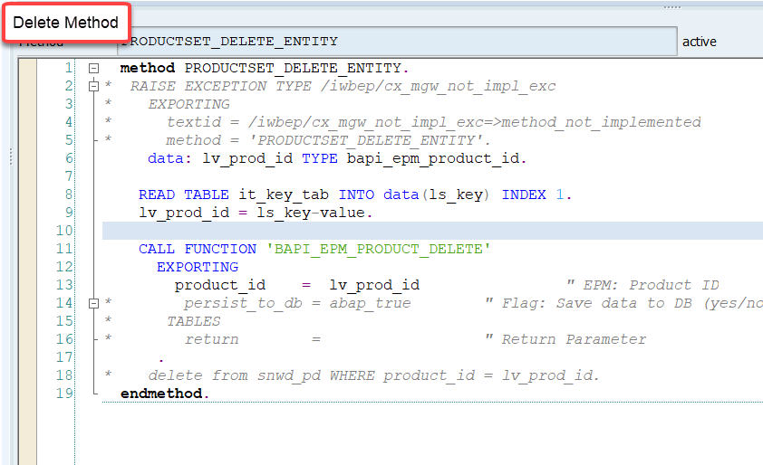
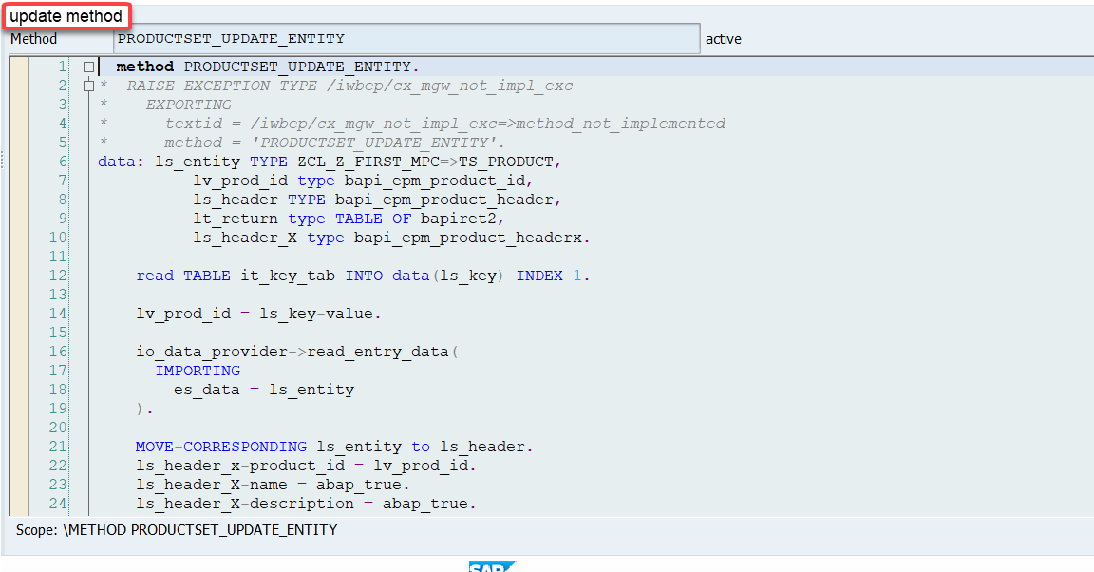
Implementing the delete and update method
We can implement the delete and update method in the cross-ponding dpc extension classes

Slide 4
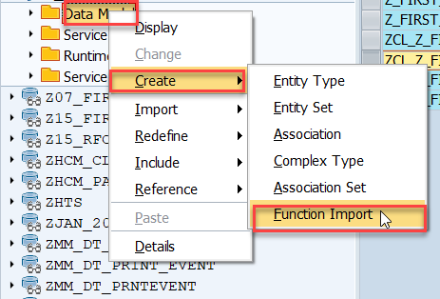
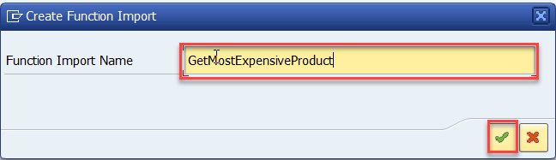
Function Import
At times, we need to implement the logic inside of OData which is not a direct CRUD operation e.g. calling a workflow, calling a BAPI which does some processing, Sending request to another server and can be invoked by the HTTP methods GET or POST .
For example: we can create the function import to GetMostExpensiveProduct in our Product set by the Category.
Step1: Right click the Data Model folder, and select Create and then select Function Import. Create Function Import dialog opens

Slide 5
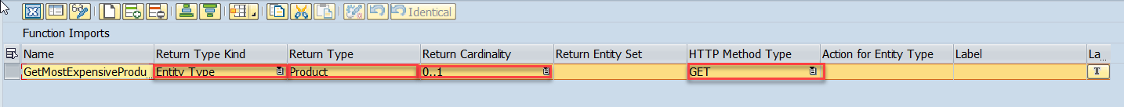
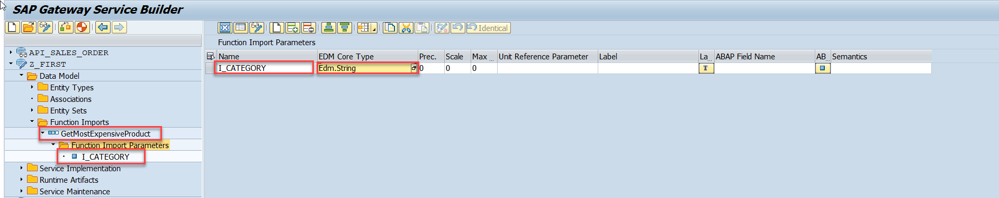
Function Import
Step2: Enter return type kind, return type, return cardinality & HTTP method Type
Step3: Giving function import parameters (I_CATEGORY)

Slide 6
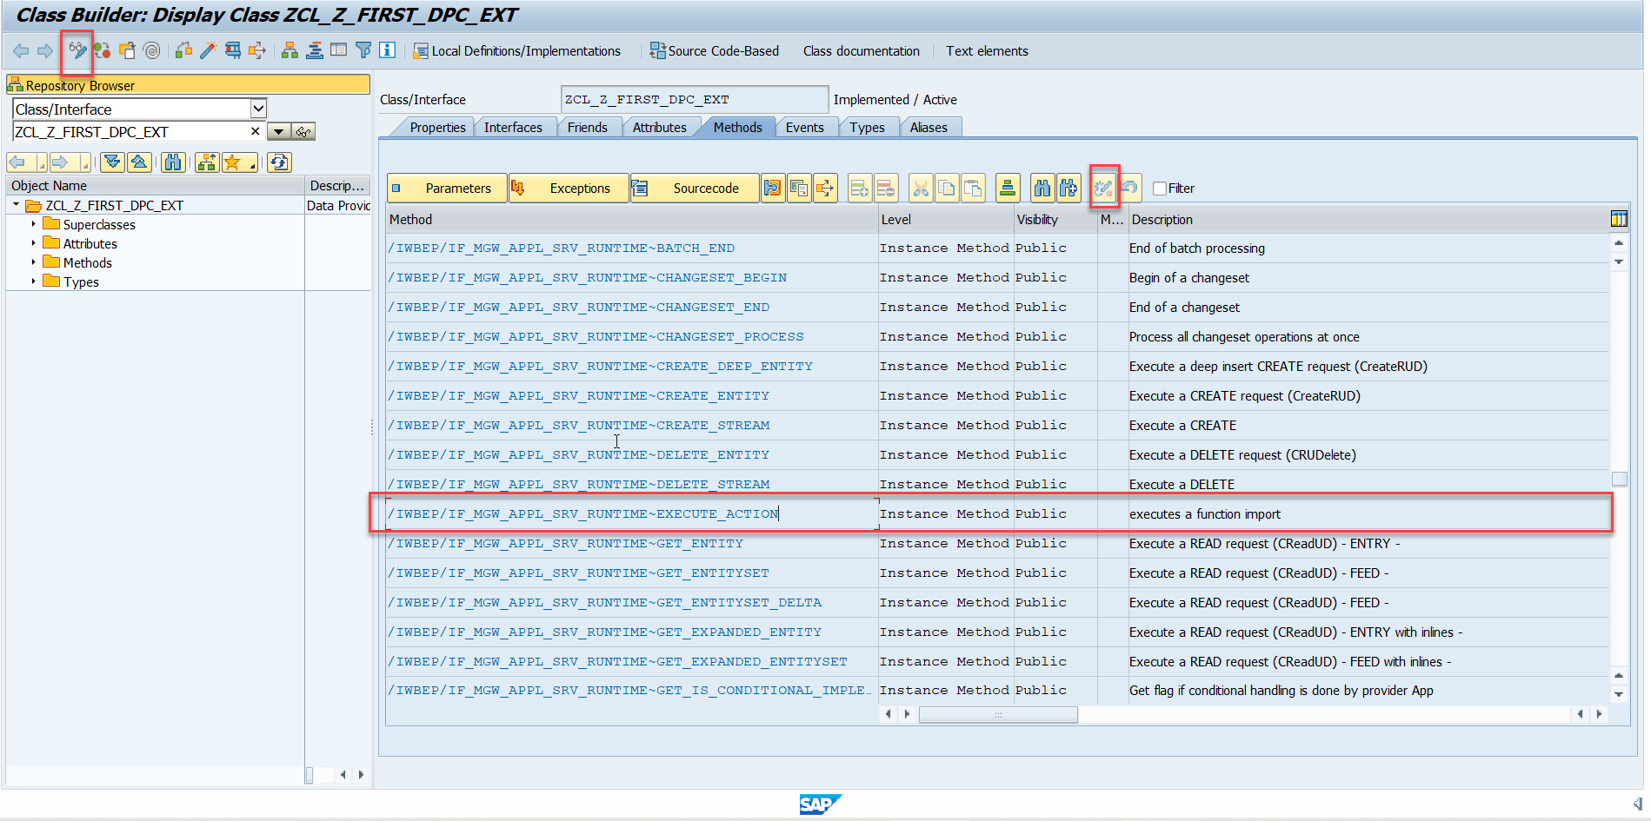
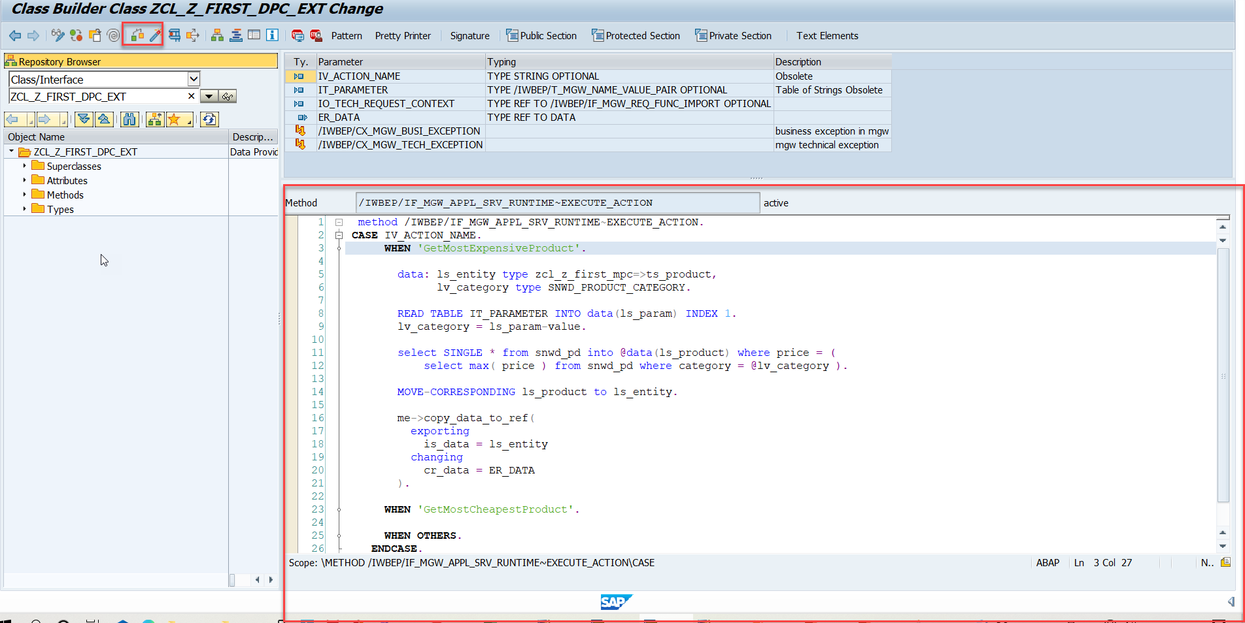
Function Import
Step4: Go to DPC Extension and search for the method--/IWBEP/IF_MGW_APPL_SRV_RUNTIME~EXECUTE_ACTION and redefine the class method

Slide 7

Exercise
Create a new Entity Set Supplier
Get the supplier header from BAPI_EPM_BP
Perform GetEntitySet and GetEntity

Slide 8
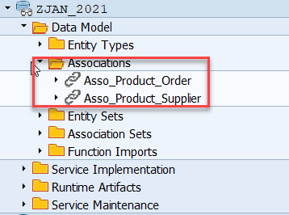
Association
Associations are relationship Between entities.
At database level we have foreign key relationship and same is reflected at odata level.
Once a association is created only then we can create navigation property.
Product
Supplier
1 relation 1
nav

Slide 9
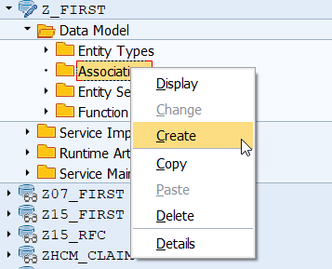
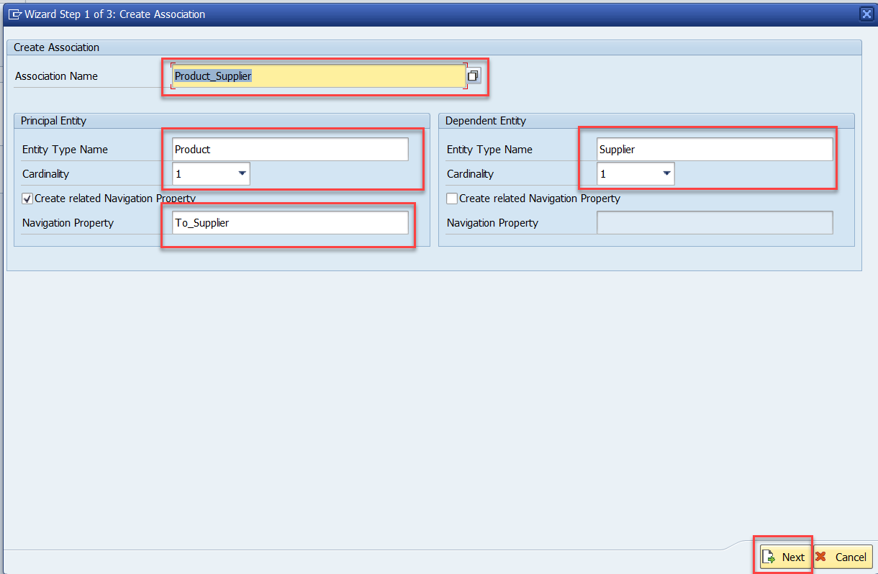
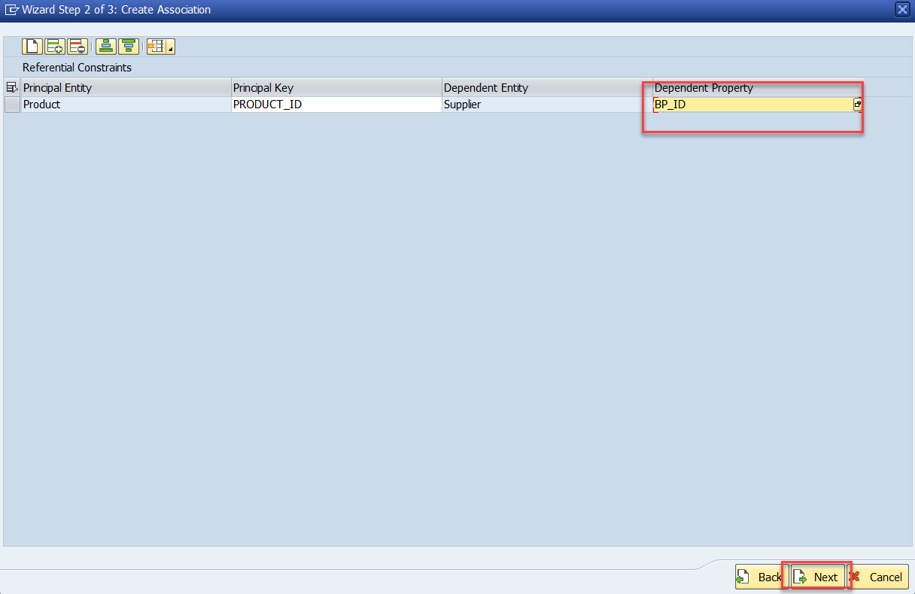
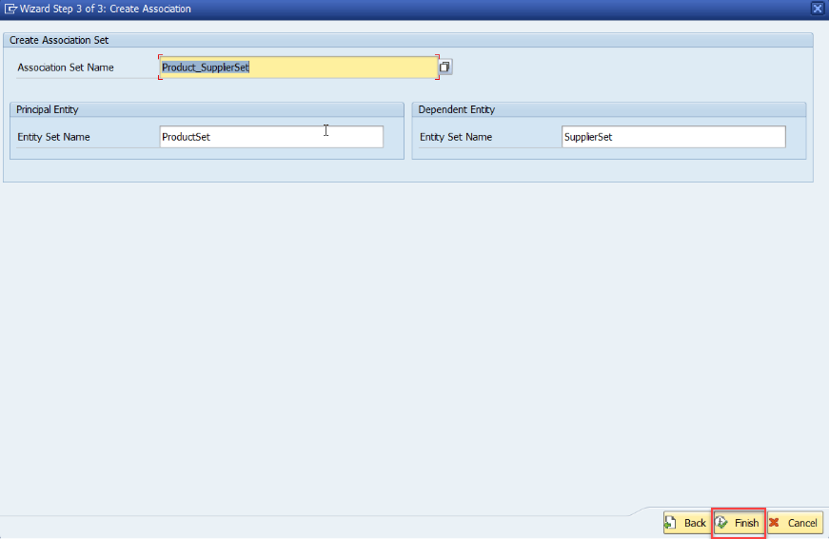
Association
Step:1 Right Click on Association and click on create

Slide 10
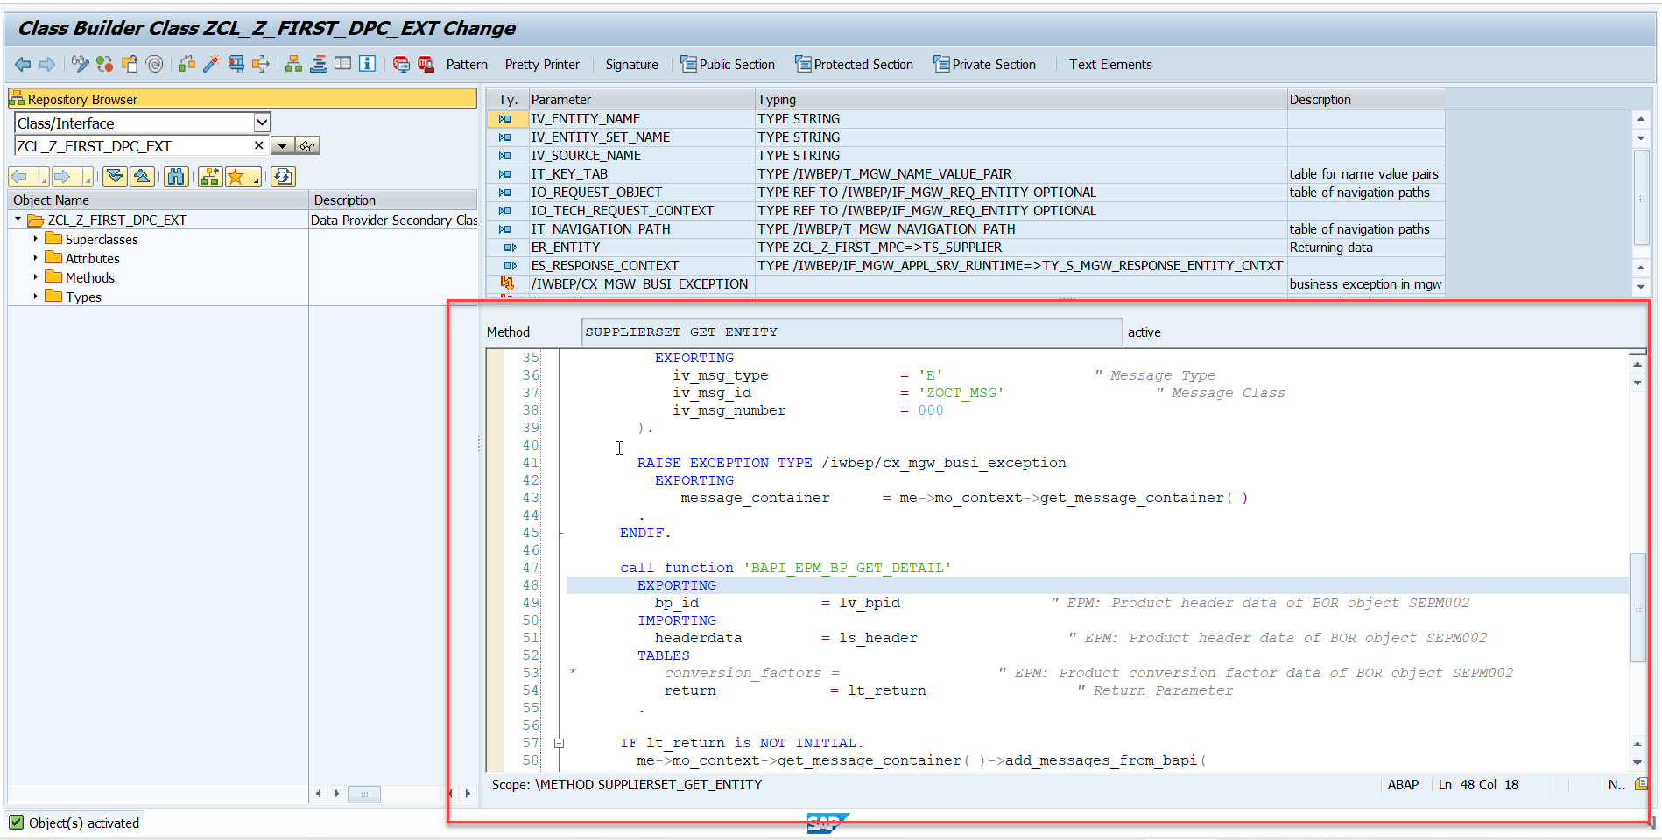
Association
Step2: Go to DPC extension and redefine the method for supplierSet GetEntity

Slide 11

Break

Slide 12

Connectivity: Role of SCC
Internet
Intranet
SAP BW
SAP ECC
SAP S/4 Hana
SAP BTP (PublicCloud)
SAP On-premise System
SAP Business Application Studio
SCC
Destination
S/4 Hana Cloud
Field Glass
Sales Force

Slide 13
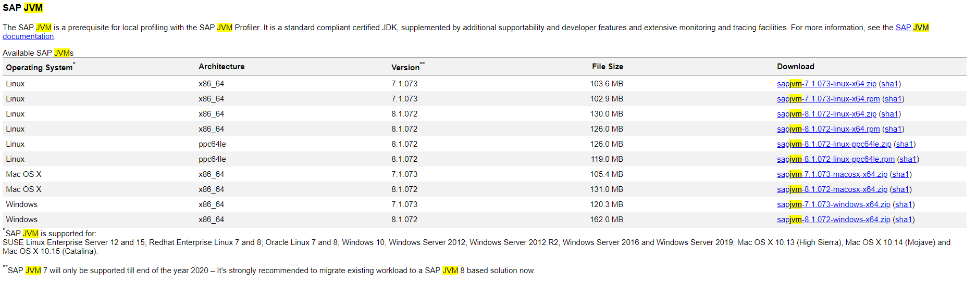
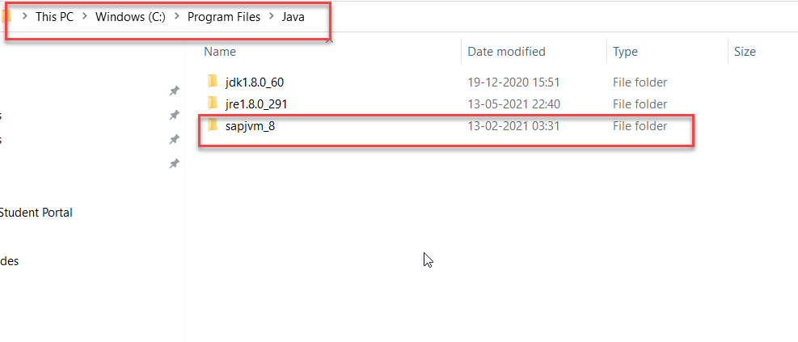
Connectivity
Step1: Download SAP JVM and Extract it in the C:\Program Files\Java

Slide 14
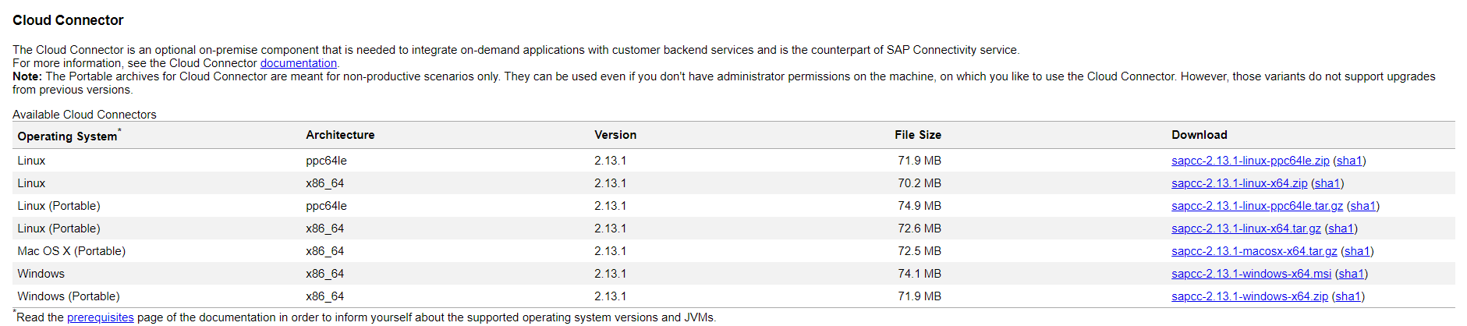
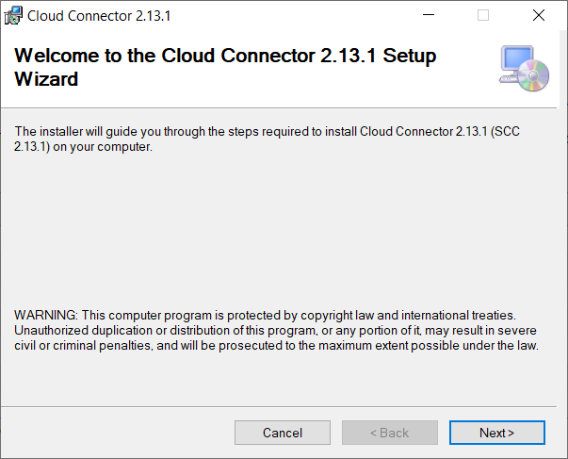
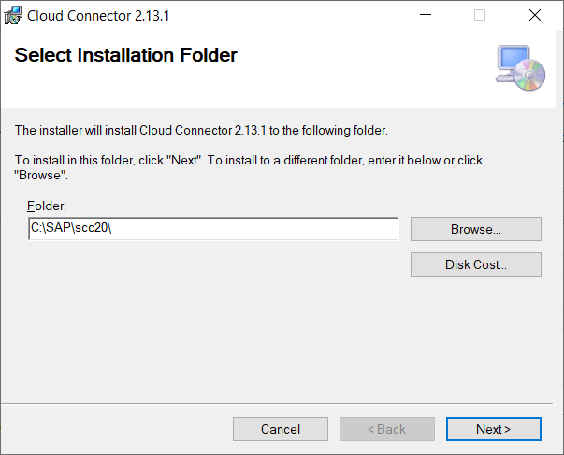
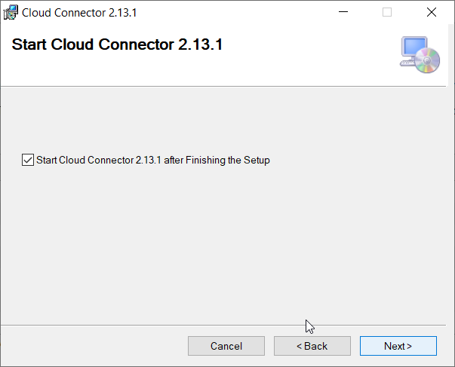
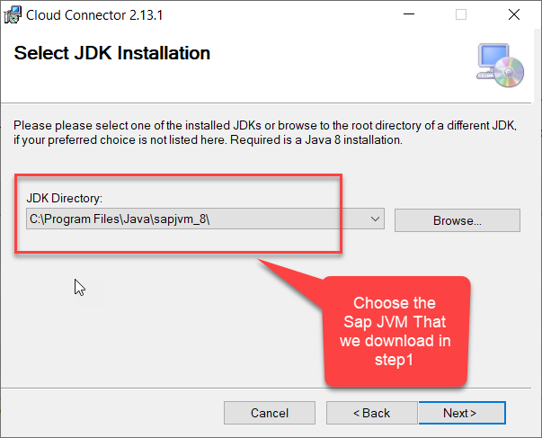
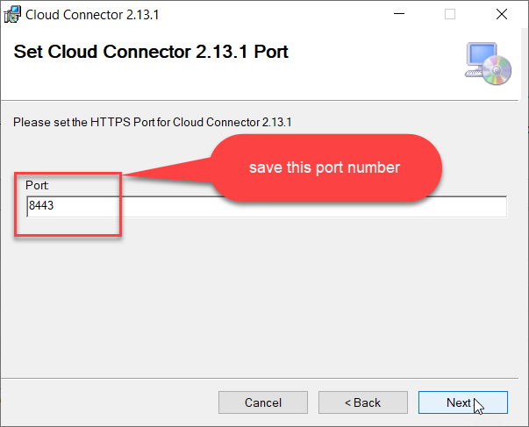
Connectivity
Step2: Download and install the sap Cloud connector

Slide 15
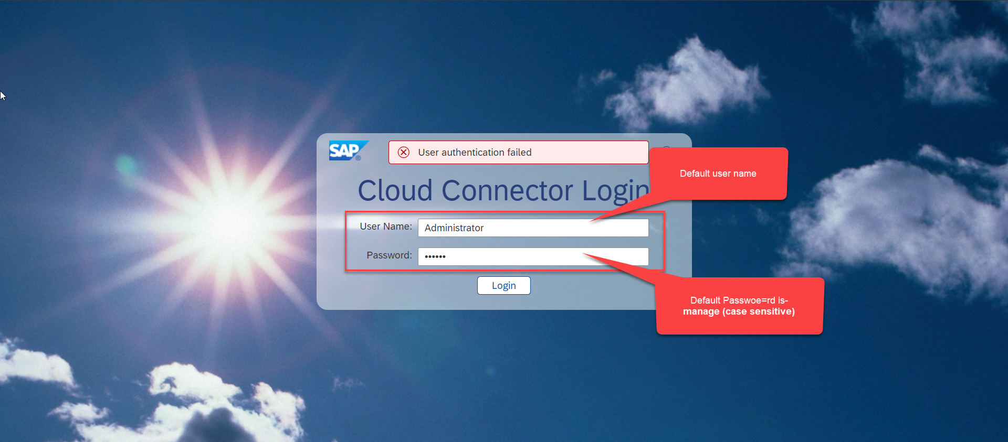
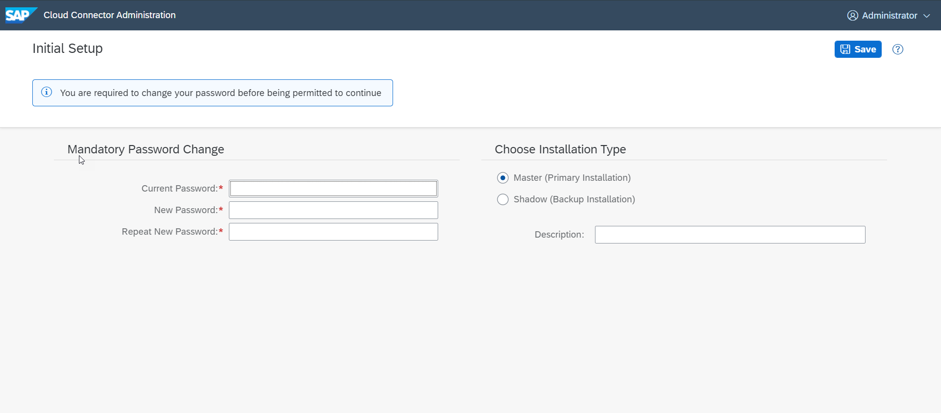
Connectivity
Step3: Now your system is ready go to browser and open https://localhost:8443 (port may changes)

Slide 16
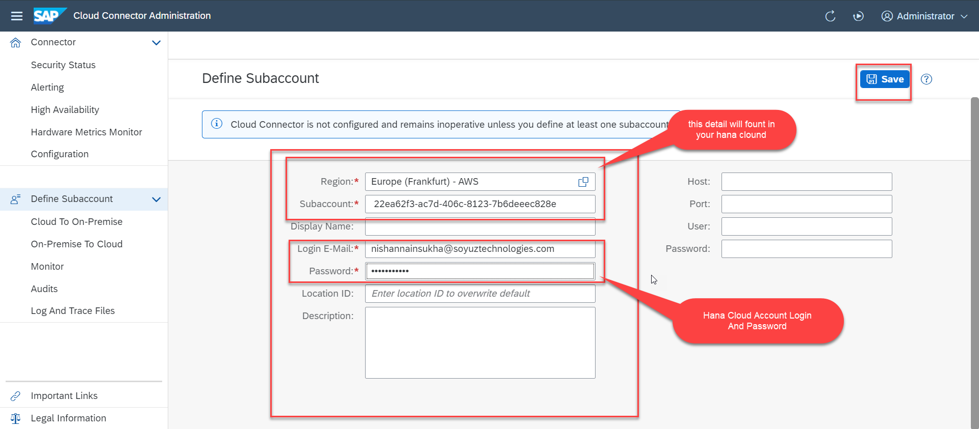
Connectivity
Step4: Now we create a connection with our Cloud Account

Slide 17
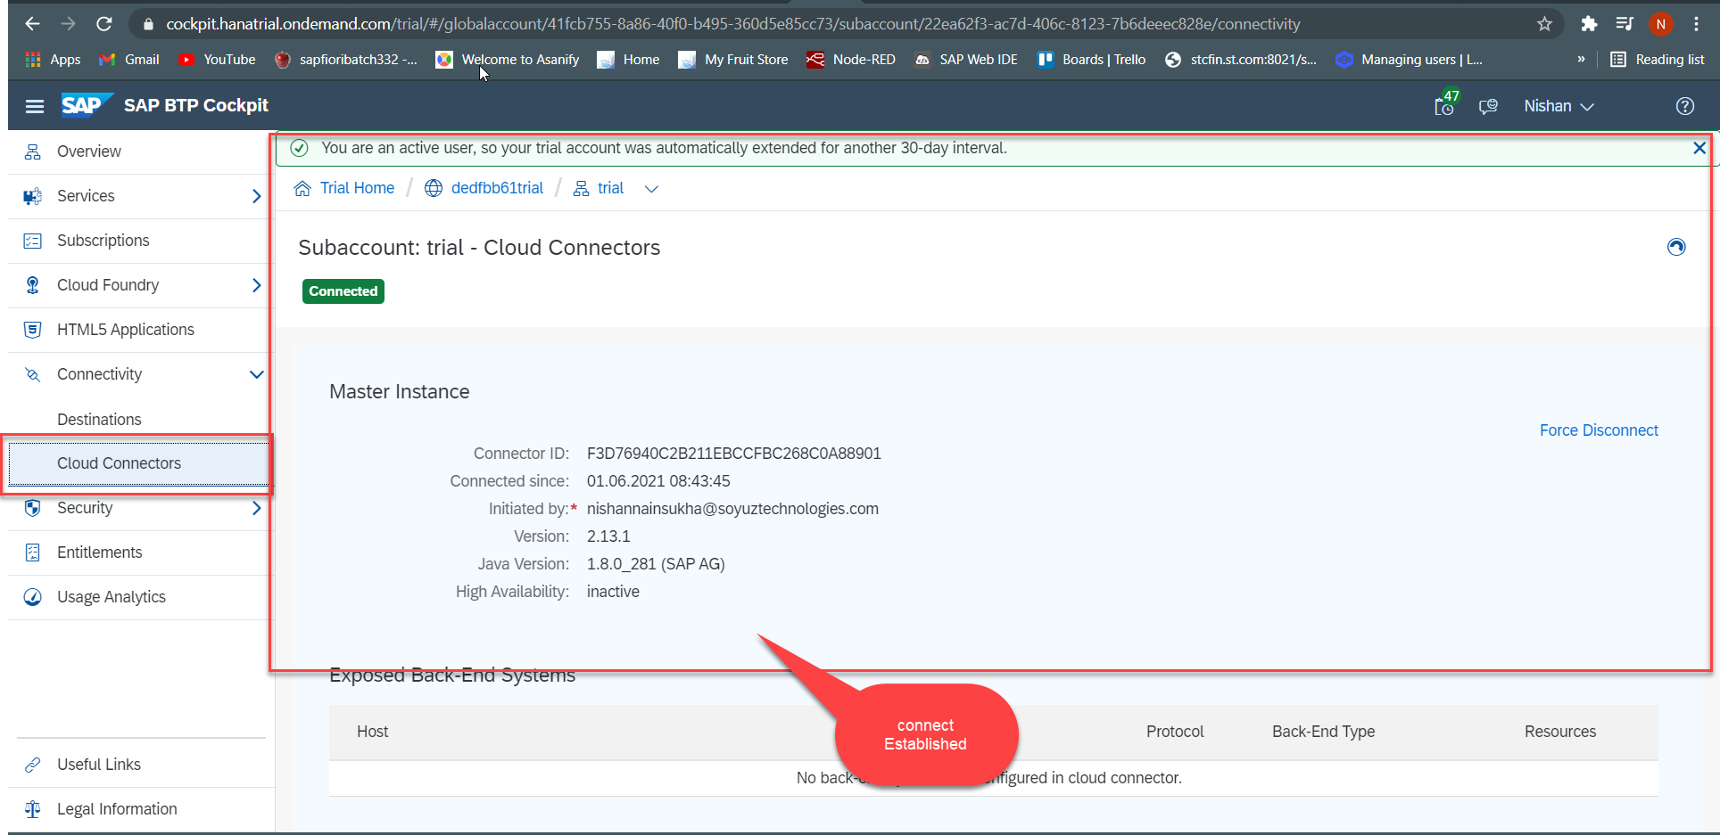
Connectivity
Step4: Check the connection on Hana Cloud Account

Slide 18
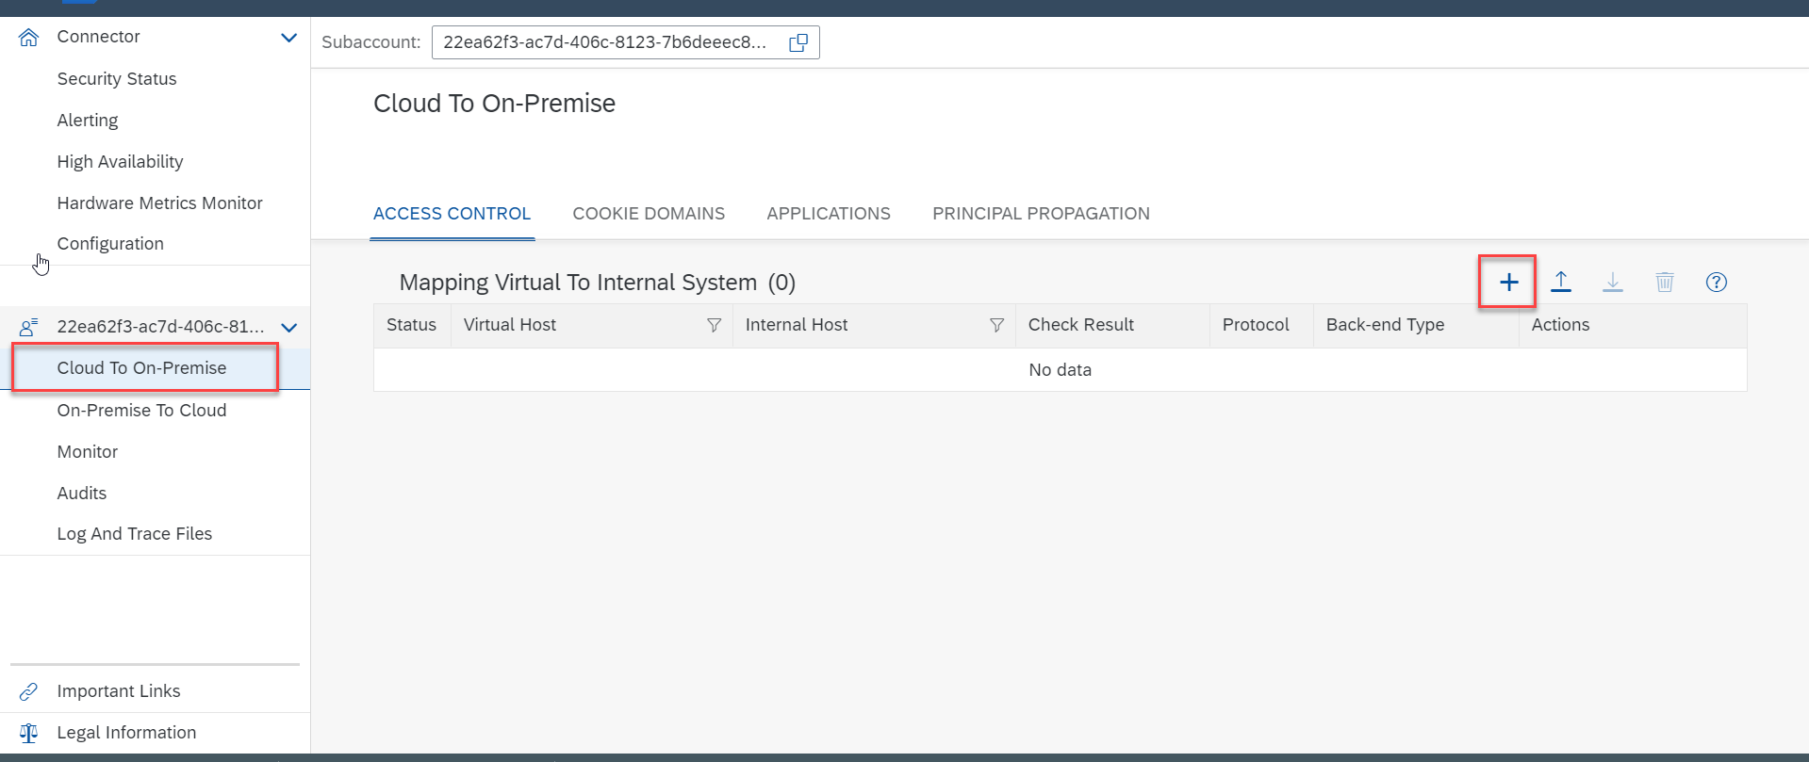
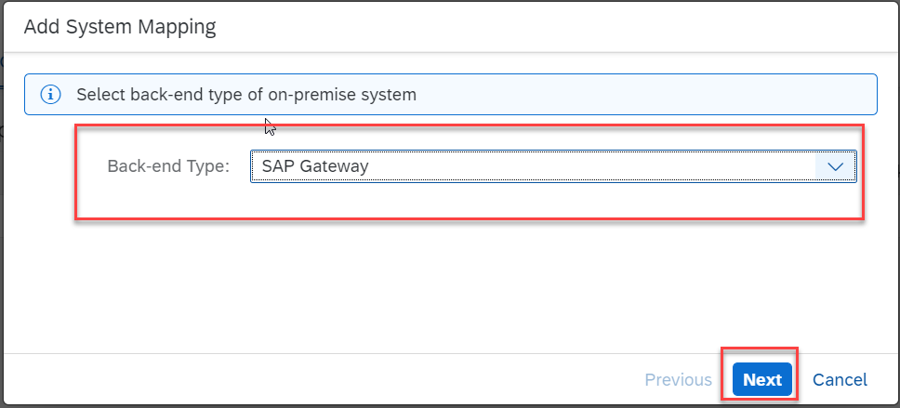
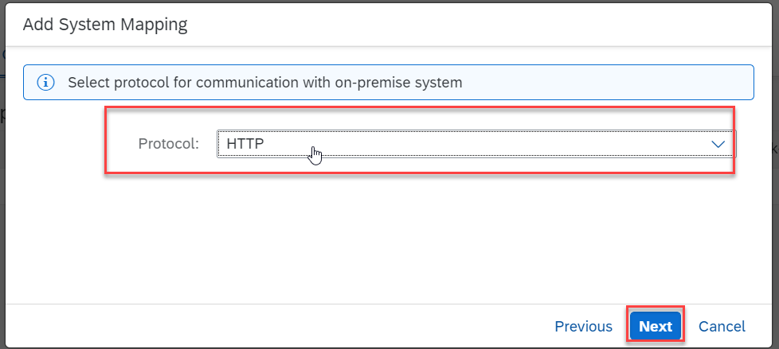
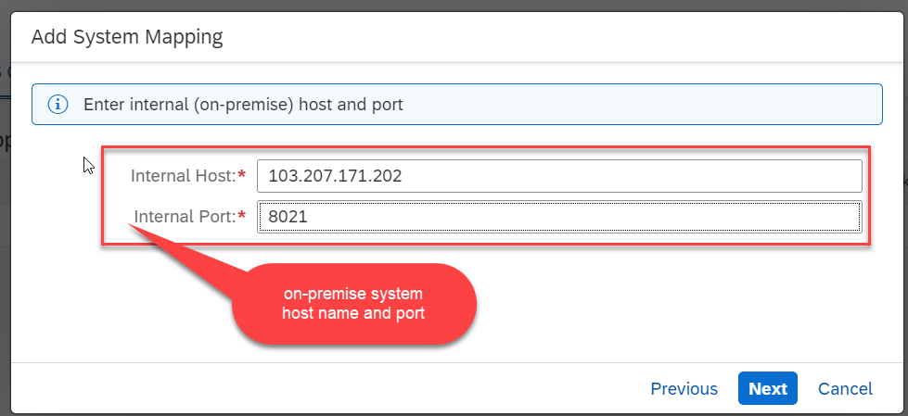
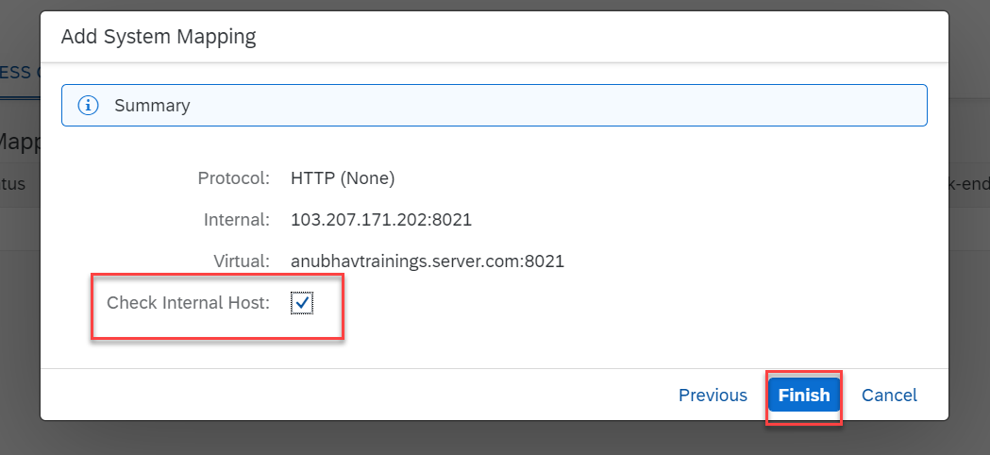
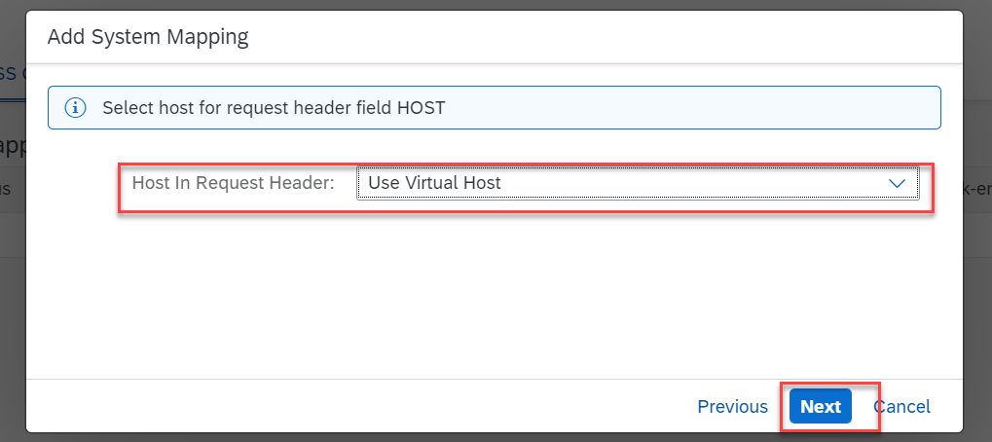
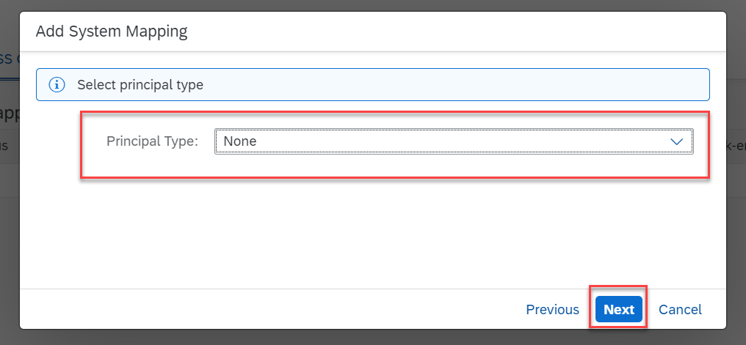
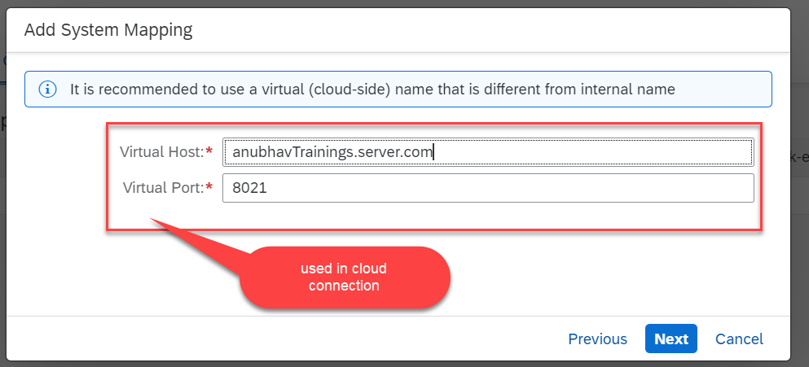
Connectivity
Step5: Connect on-premise system to cloud using SCC

Slide 19
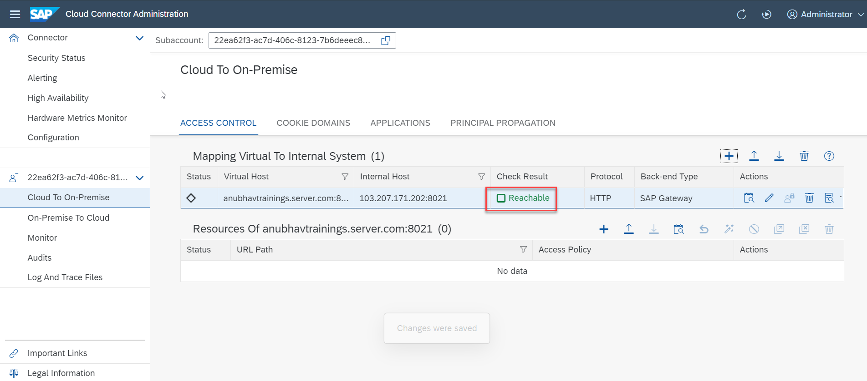
Connectivity
We Done with Connect , now we are connected with cloud using SCC

Slide 20
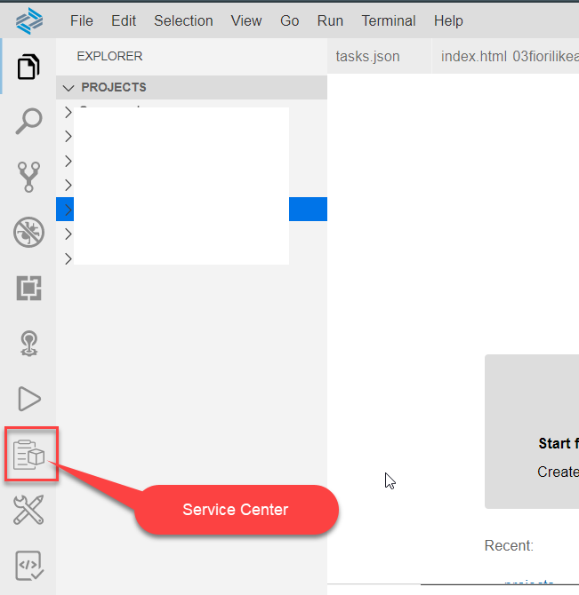
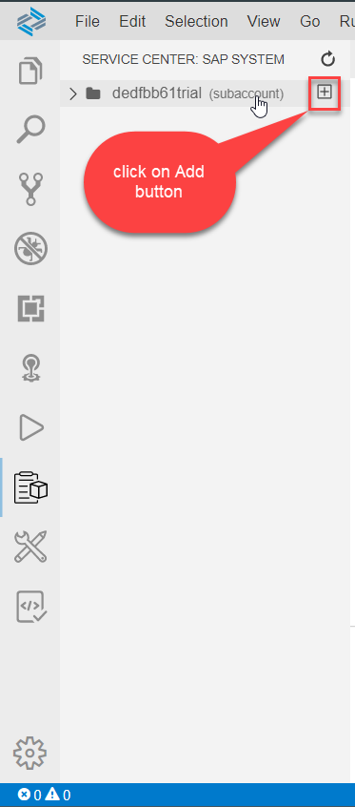
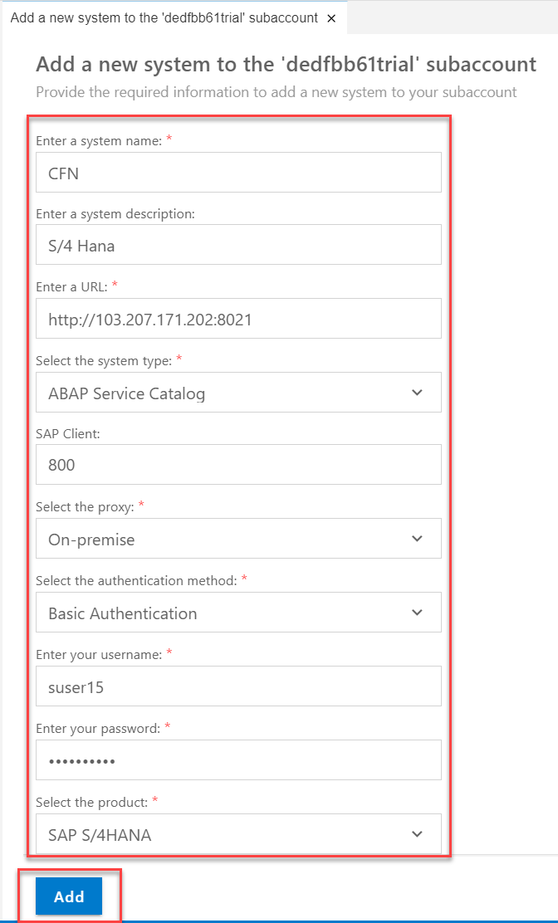
Destination
Go to BAS and Click on Service Center Icon in the Left Vertical Menu Bar and click on add

Slide 21
BAS Fiori App Configuration
Step1: Create xs-app.json file in your project folder.
{
"welcomeFile": "/index.html",
"authenticationMethod": "none",
"routes": [
{
"authenticationType": "none",
"csrfProtection": false,
"source": "^/sap/opu/odata/sap/Z_FIRST_XX_SRV/",
"destination": "CFN"
},
{
"source": "^(.*)$",
"target": "$1",
"service": "html5-apps-repo-rt"
}
]
}

Slide 22
BAS Fiori App Configuration
Step2: Enhance the manifest code
Step3: Go to terminal and open your project folder and run command npm init, it create a package.json file to the project folder
Step4: Run the application from run configuration.
Step5: Change the View1.xml
Step6: Change the View2.xml
Step7: Change the moreinfo.fragment
Step8: Change the supplierTab.fragment
Step9: Change the View1.controller
Step10: Change the View1.controller
Step11: add Add.view.xml
Step12: add Add.controller.js

Slide 23
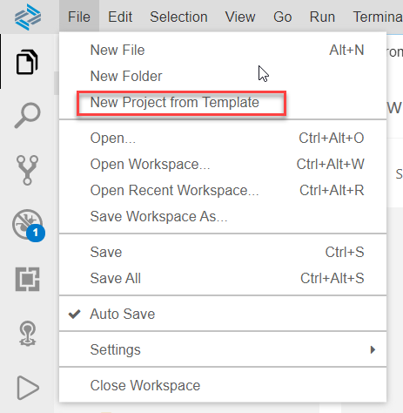
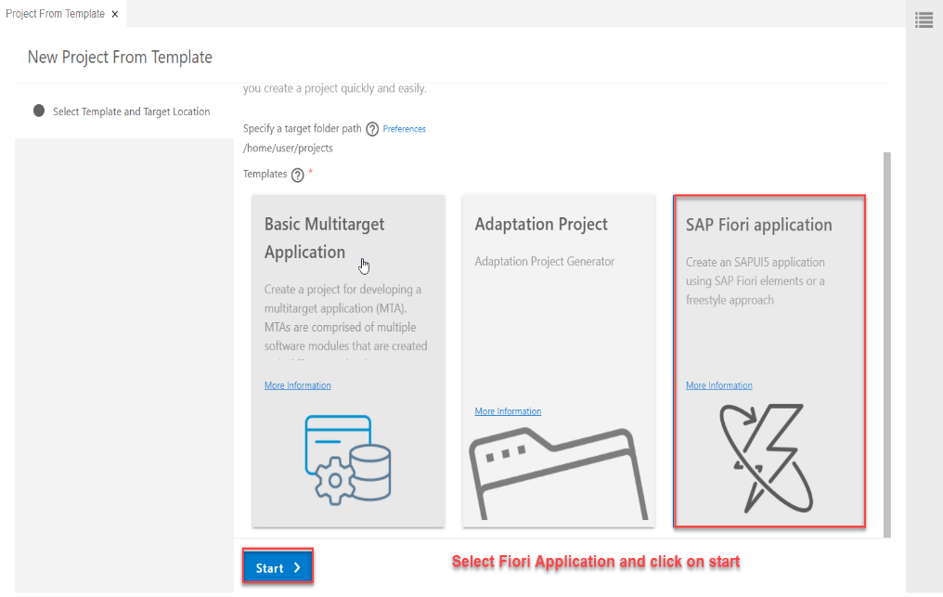
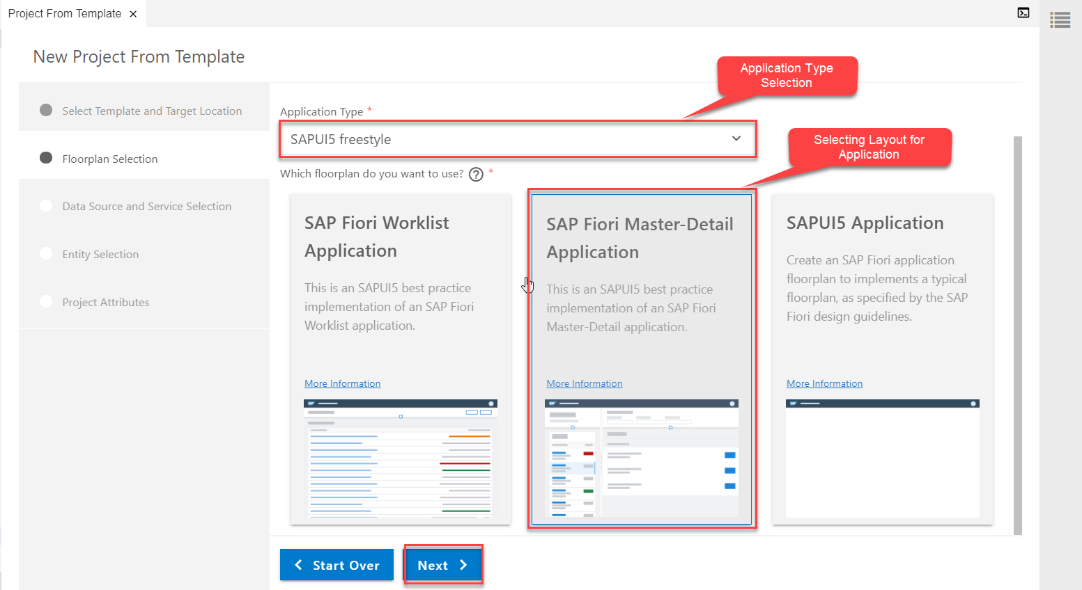
Consuming Northwind OData service
Creating a Fiori Application From Template which Consumes Northwind OData service
Step1: Starting Project from Template
Project From Template
Template Selection (Fiori Application)
Application Type & Layout

Slide 24
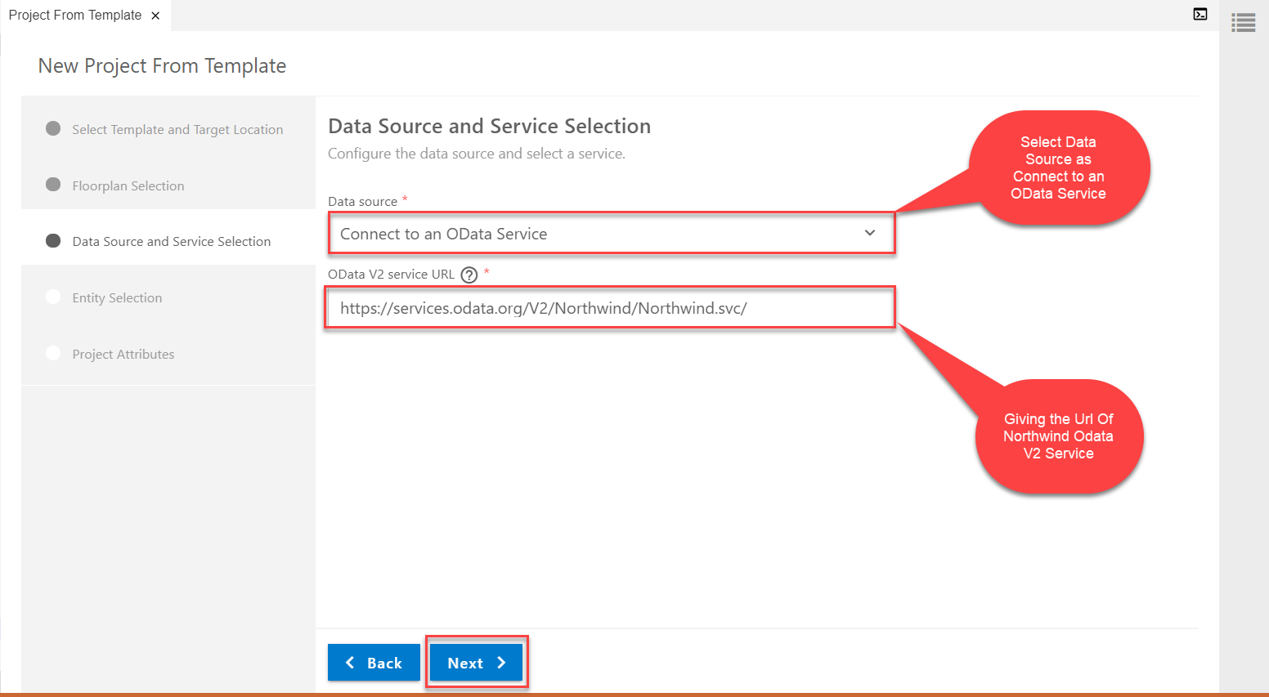
Consuming Northwind OData service
Step2: Data Source and Service Selection
service url: https://services.odata.org/V2/Northwind/Northwind.svc/

Slide 25
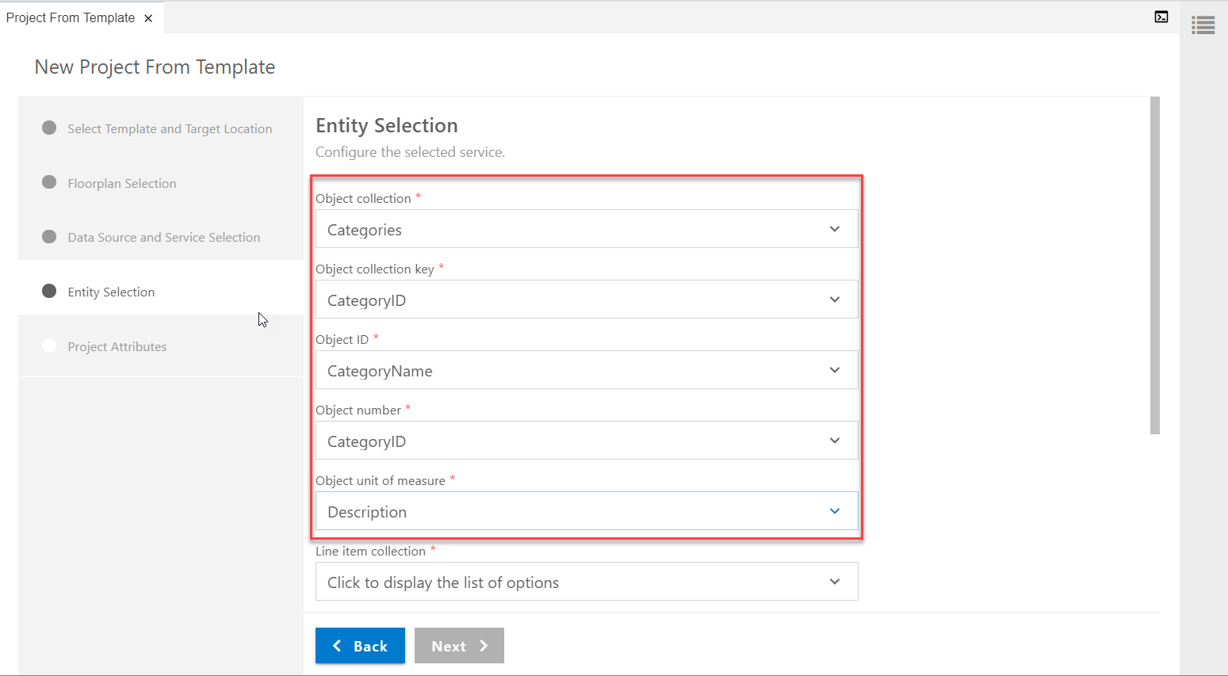
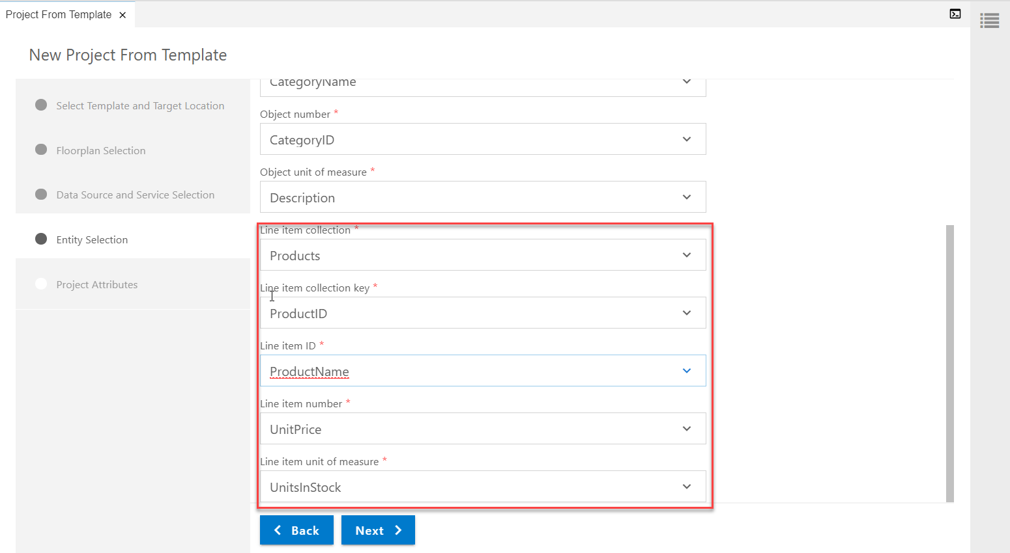
Consuming Northwind OData service
Step3: Entity Selection
3.1 Object Selection(to be viewed in Master Page)
3.2 Line Item Selection (to be viewed in Detail page)

Slide 26
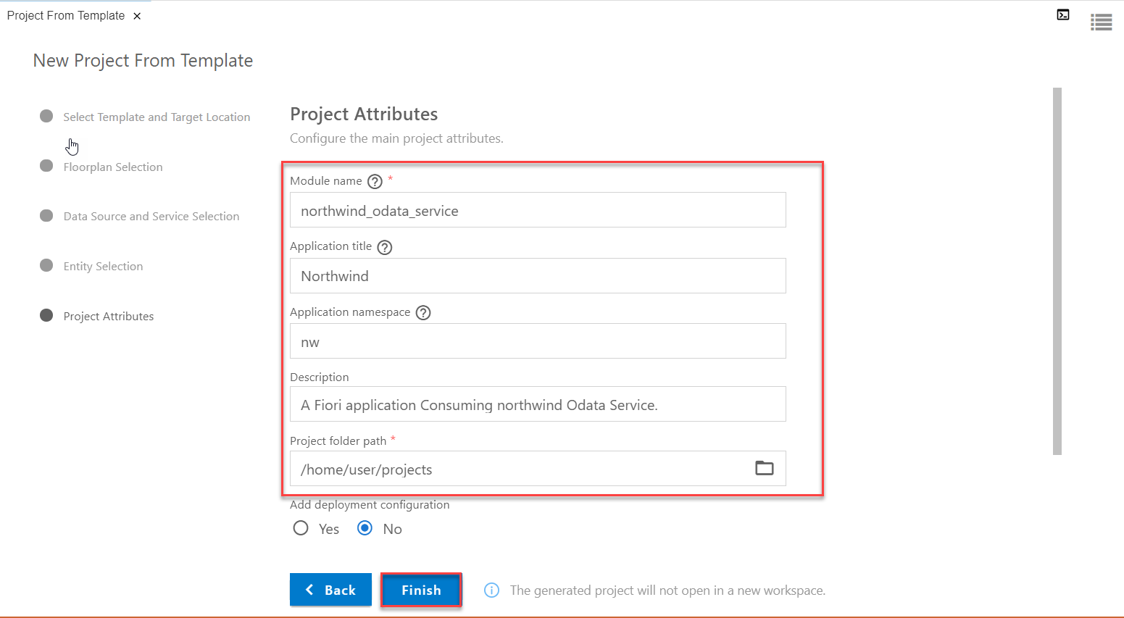
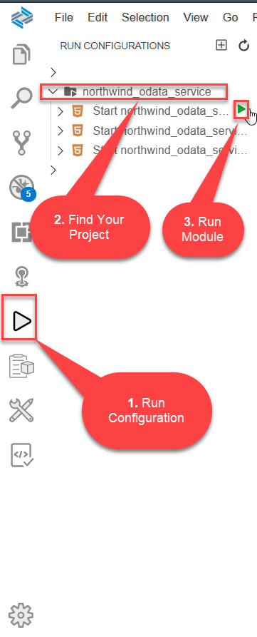
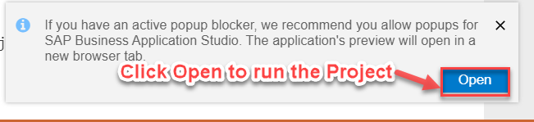
Consuming Northwind OData service
Step4: Finalizing the Project
Step5: Run the project from Run Configuration

Slide 27
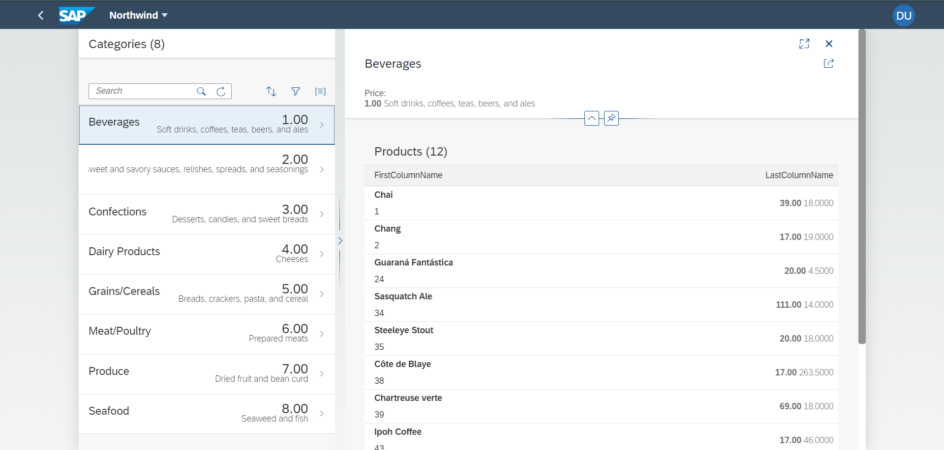
Consuming Northwind OData service
Final Project With Northwind OData Services (i18n File)

Slide 28

End of Day 7

Slide 29

Questions

Slide 30

Anubhav Oberoy

Slide 31


We’re committed to empower you to be
Most Desirable Resource
through powerful training solutions.
We build the workforce of the future.
250+
Corporate Clients
30,000+
Learners Trained
25000+
Learners Placed
FREE WEBINARS
Sign up for free webinars with industry experts every fortnight!
Enroll Now!
Contact us today!
https://anubhavtrainings.com/

Slide 32




More from AnubhavTrainings.com

Slide 33
Title
Content

